Slide 1
Notes:
Morning---
My hope for presentation to share with you how we conducted our 5 week campaing-Importance of Sharing Ideas/Marketing efforts/sharing

Slide 2
WHY?
Tuition
Annual Giving
Another
Special Event
Special Event
Classroom Requests
Notes:
How’d we get to the 5 Week Campaign?
Overall, our parent participation and support of the School is very high—I’d say 100%, but we were struggling with low participation in the Annual Fund.
Importance of direct giving and teaching about true philanthropy—not purchasing—and 100% impact, no cost of special event
So we started talking to our parents and we took a look at all we’re asking parents to do---Show the Slides
After hearing about a few schools who had conducted campaigns we decided to FOCUS our Fundraising Efforts

Slide 3


Slide 4


Notes:
So, we told them—We Heard you! Send this postcard out to give them a little education (didn’t go to our new parents). We also make them a promise, it’s 5 Weeks and 5 Weeks Only. We were not going to go back to the community again for the Annual Fund—even if that meant coming in under budget—which we did discuss with our Board.

Slide 5
HOW

Slide 6
The 5 WEEK Campaign
Timeline
Postcard Announcement-2 Months Out
Appeal Letters-1 Week Prior to Launch
  Segmented Appeals
    Annual Donors-Increased ask with amount
    Annual Donors-SGLY
    Annual Donors-Ask to consider increase
    SYBUNTS
    Non Donors
    Scholarship Families Annual Donors
    Scholarship Families SYBUNTS
    Scholarship Families Non Donors
    New Parents
Weekly Outreach
  Eblasts every Monday night
  Posts in School newsletters each week
  Flyer home in student’s folders 1x per week
  Class Ambassador Outreach
Notes:
So, in an order to structure this presentation, I wanted to pull apart the different components of our timeline, marketing efforts etc…but they overlap and really all rely on one another—if I jump around a bit, I hope it makes sense—please stop me if it doesn’t.
As you previously saw, we mailed out the We Heard You postcard-2 months prior to our launch-as a save the date and to give them a heads up. After that—it was quiet time until the 5 Weeks.
It was important that it truly felt like 5 Weeks and not 3 weeks of pre-talk—so really 8 weeks.
A week before launch we send out our appeals. I do a great deal of segmenting and I have found that this works really well for our community, and I’ll be able to share some of those results with you later in the presentation.
Then, we had a schedule that we maintained through out the 5 Weeks.

Slide 7
Class Ambassadors
40 Current Parent Volunteers
  Representing all grade levels
  Grade level Teams
Ambassador Outreach
  Email/Phone Calls
    Week 1-Email of Introduction and notice of impending outreach
    Week 2- Outreach (email or phone) to Last Year’s Donors
    Week 3-Shhhhh—quiet time
    Week 4-Outreach (email or phone) to Non-Donors
    Week 5-Outreach (phone encouraged) to all who have not made a commitment
  Presence on Campus
    Every Monday at morning Drop-Off
    Final Week-Every Day
Notes:
Wait until week 2-let’s people get their gifts in before we start calling
No amounts—just encouraging participation and answering questions, how to pay. We work hard to stress that while we are conducting a shortened campaign, we don’t except to receive all the funding during that time. Pledges are important, a commitment to participate with a time that we can contact or reach out to them again. Smart—no payment in Feb..make AF gift.
On campus—playfully obnoxious

Slide 8
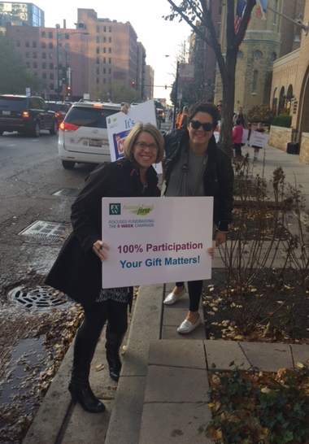
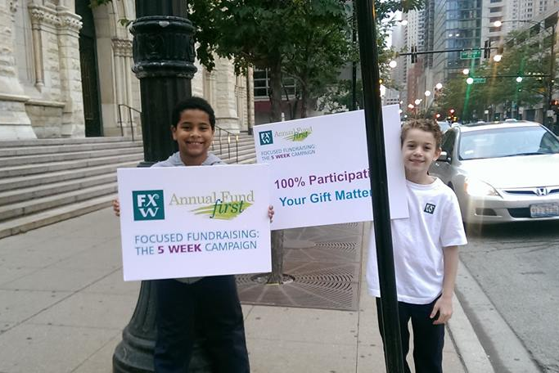
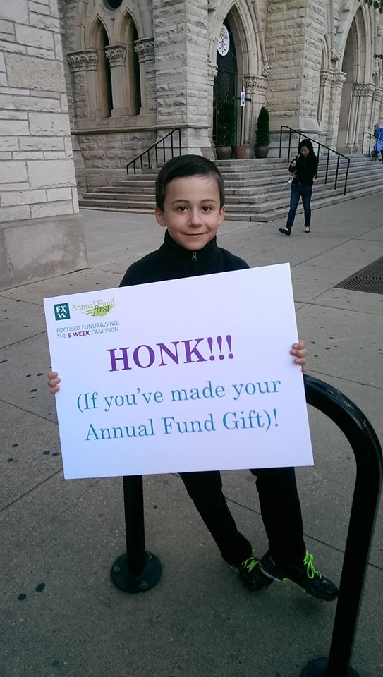
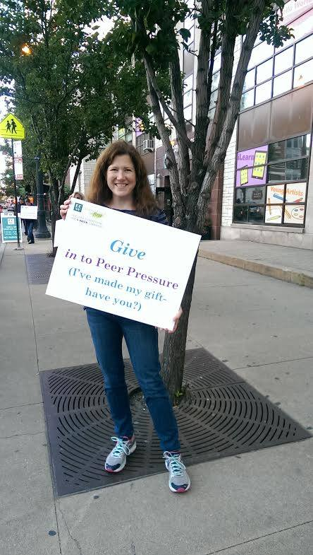
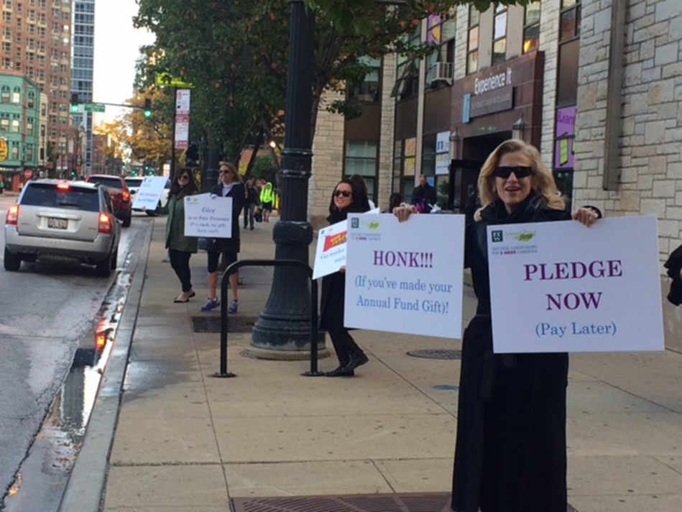

Slide 9
Marketing
(an investment)
Focused Fundraising
Week 1: Faculty and Staff Professional Development
Week 2: Everyday Expenses
Week 3: Shared Values
Week 4: Curriculum
Week 5: The Mission (Your School)
Notes:
One of the biggest components to our campaign is our Marketing. We made a choice to invest in these efforts in order to really draw special attention to it. IT’s not a special event, it doesn’t a fancy theme, with glamours invitation, people don’t get to put on their gowns and suits when they make their annual fund gift. So, we thought—well, let’s give it a little bit of that. Last year, we invested in these quick draw videos. And this year we have theme of “many Pieces work together” Last year, every Monday evening the would receive an email from us with the Theme of the week and a video that spoke to that theme. Instead of showing you each video here is our final video that tied everything together.

Slide 10

Video

Slide 11

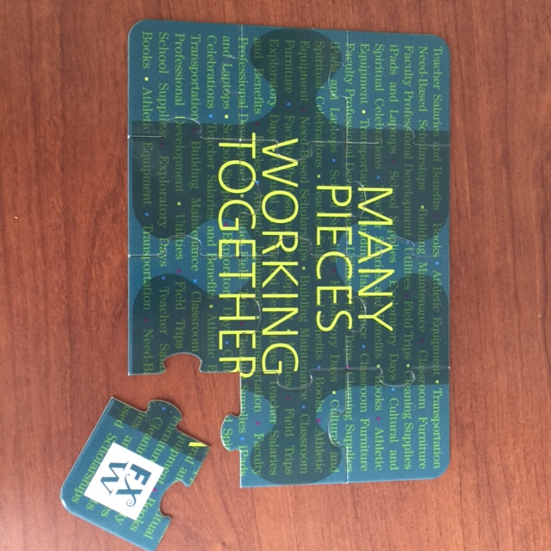


Slide 12

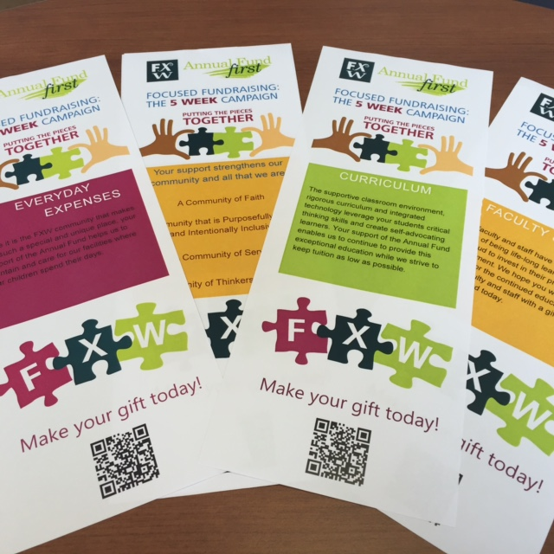



Notes:
You’ll notice that our Themes for the week have maintained, given that what the Annual Fund supports hasn’t changed—really believe repition is important in order for them to really learn about what they are supporting.

Slide 13


Slide 14



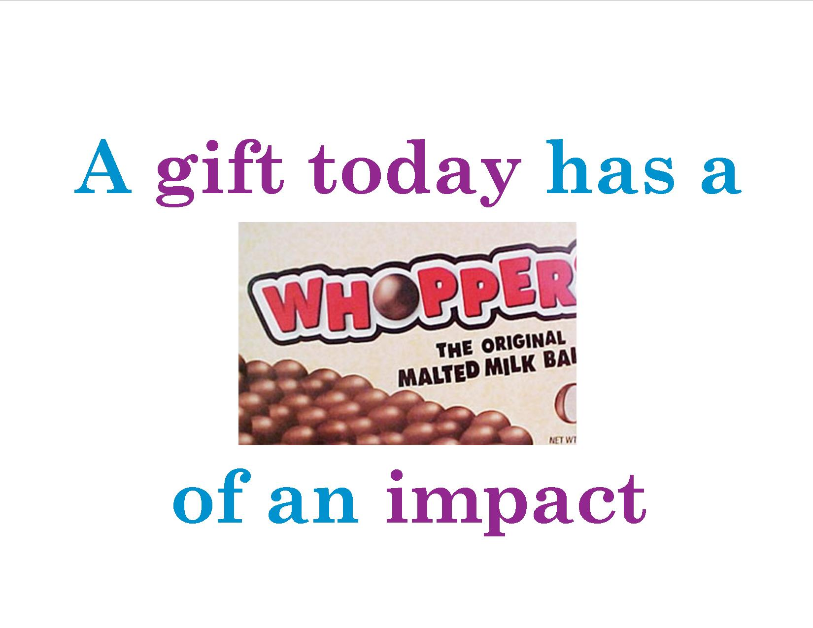

Slide 15
RESULTS

Slide 16

Parent Annual Fund benchmarks
 | Families in School | Families Participated | % Families Participated
FY13 | 620 | 389 | 63%
FY14 | 640 | 405 | 63%
FY15 | 630 | 381 | 60%
FY16 | 638 | 516 | 81%
In FY16
122 families did not make a gift (area of opportunity)
66% of families receiving assistance made a gift to the annual fund

Slide 17
Parent Annual Fund
Participation by Grade Level
Class | Grade | Total Families in Grade | FY16 Participation | FY15 Total Families | FY15 Participation
2026 | Pre3 | 80 | 85%
2025 | Pre4 | 95 | 82.11% | 83 | 80.72%
2024 | K | 90 | 81.11% | 92 | 59.78%
2023 | 1 | 88 | 92.05% | 95 | 69.47%
2022 | 2 | 98 | 91.84% | 94 | 73.40%
2021 | 3 | 91 | 79.12% | 90 | 60.00%
2020 | 4 | 84 | 82.14% | 88 | 68.18%
2019 | 5 | 85 | 80.00% | 83 | 67.47%
2018 | 6 | 76 | 65.79% | 73 | 49.32%
2017 | 7 | 92 | 70.65% | 92 | 67.39%
2016 | 8 | 74 | 62.16% | 73 | 57.53%
Notes:
Here is our breakout via classes….If you note our lower school %’s—it’s important to note that we started an initiative about 3 years ago with all new parents, called Parents in Partnership. We meet with each new family individually to get to know them and to share with them the ways they can philanthropically support the school during their time here. Since we’ve started that the new families have actually averaged a higher percentage of participation than the school as a whole.

Slide 18
Parent Annual Fund
5 Week Analysis
Participation Per Week
 | Prior | Week 1 | Week 2 | Week 3 | Week 4 | Week 5 | Post
Participation | 1% | 7% | 11% | 13% | 15% | 30% | 4%

Slide 19
Parent Annual Fund
FY14 /FY15 to FY15/FY16
Donor Trends Comparative Report

Slide 20
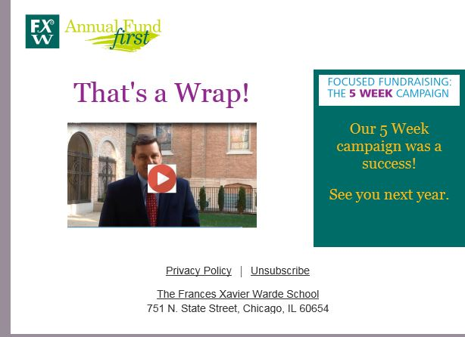
Video

